Slide 1
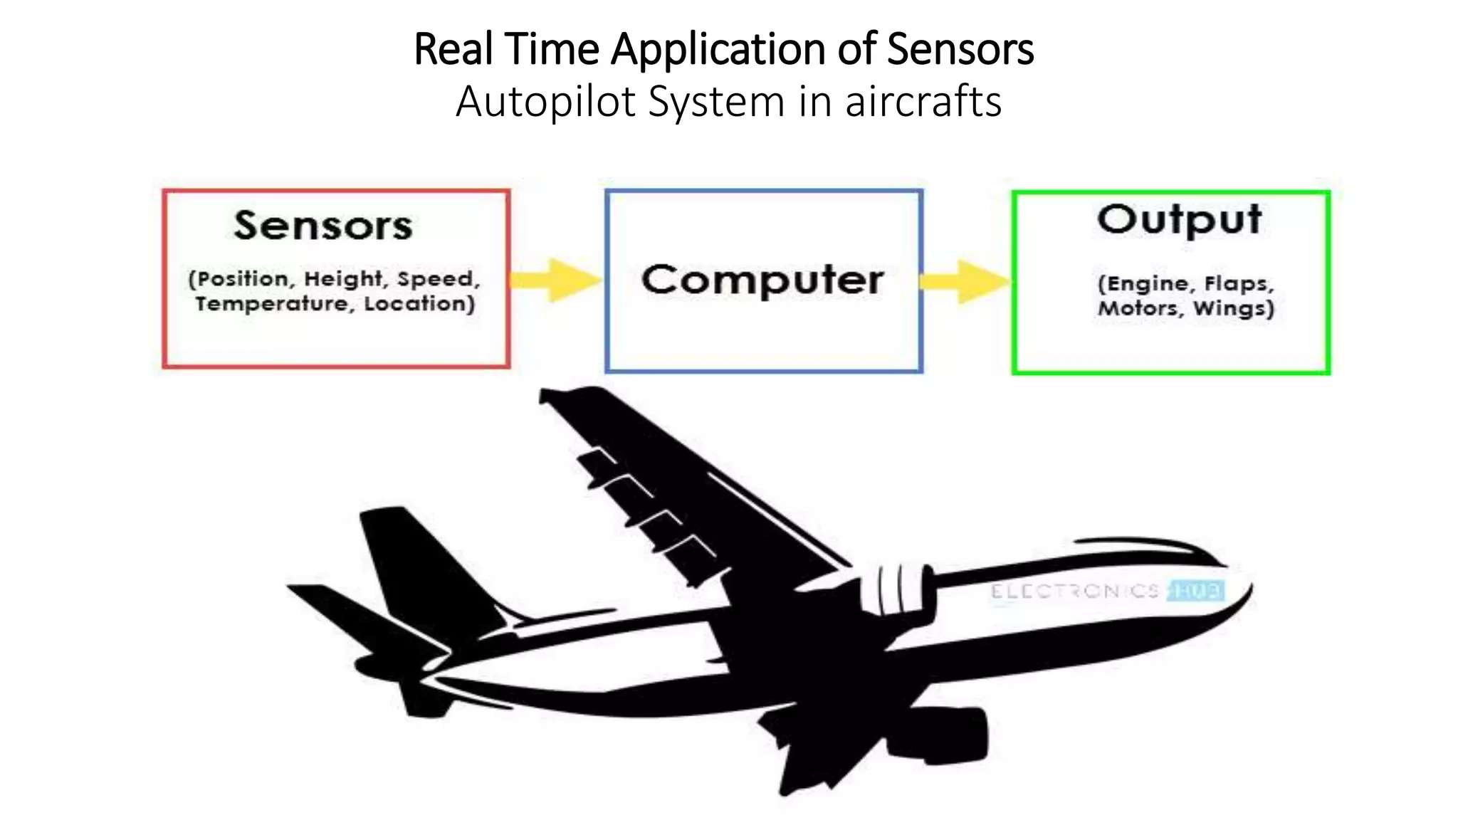
Part 3: IOT Sensors & Actuation
By Dr. Masyitah Abu

Slide 2
What is Sensor?
Sensor as an input device which provides an output (signal) with respect to a specific physical quantity (input)
The term “input device” in the definition of a Sensor means that it is part of a bigger system which provides input to a main control system (like a Processor or a Microcontroller).
Another unique definition of a Sensor is as follows: It is a device that converts signals from one energy domain to electrical domain.

Slide 3
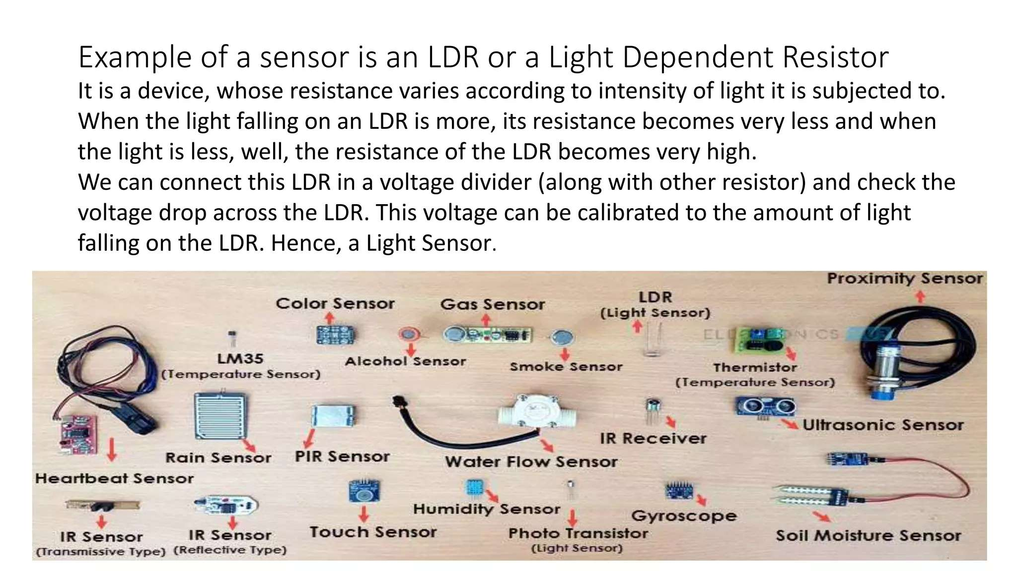
Example of Sensor

Slide 4
Classification of Sensors
Sensors can be classified is several class:
Active Sensors
Passive Sensors
Analog Sensors
Digital Sensors

Slide 5
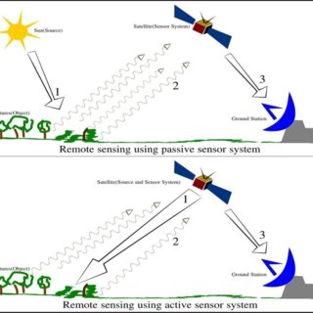
Active Sensors
Those which require an external excitation signal or a power signal.

Slide 6
Passive Sensor
Do not require any external power signal and directly generates output response

Slide 7
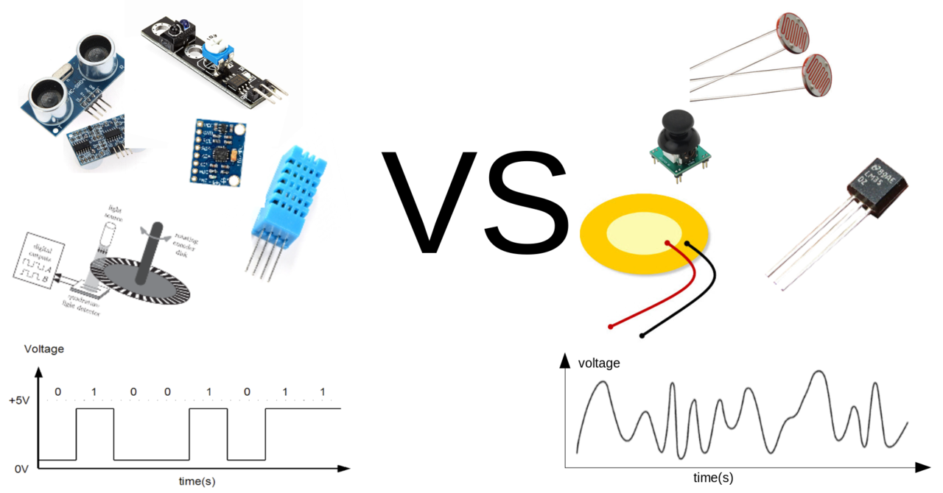
Analog Sensors
Produce an analog output for example continuous output signal with respect to the quantity being measured.

Slide 8
Digital Sensors
Work with discrete or digital data. The data in digital sensors which is used for conversion and transmission, is digital in nature.

Slide 9
Types of Sensors
There are also several types of sensors:
Temperature Sensor
Proximity Sensor
Accelerometer
IR Sensor (Infrared)
Pressure Sensor
Ultrasonic Sensor
Smoke, Gas and Alcohol Sensor
Touch Sensor
Color Sensor
Humidity Sensor
Tilt Sensor
Flow and Level Sensor

Slide 10
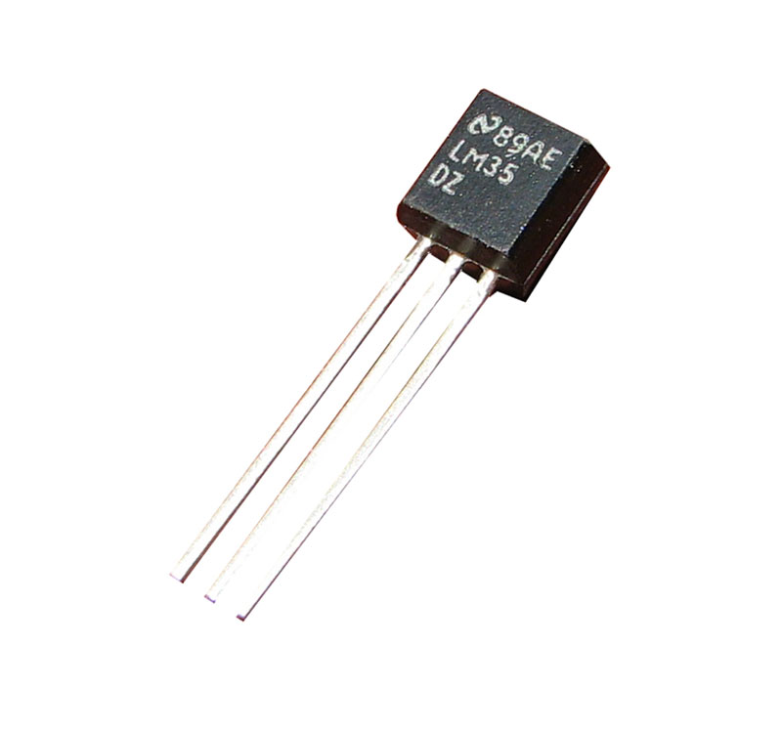
Temperature Sensor
The most common & popular sensor
How it work?
It changes its physical property like resistance or voltage when the temperature change.
LM35 is a Celsius scale temperature sensor devices with its output directly proportional to the temperature (-55 to +150 Celsius)
What Thermistor & Thermocouple

Slide 11
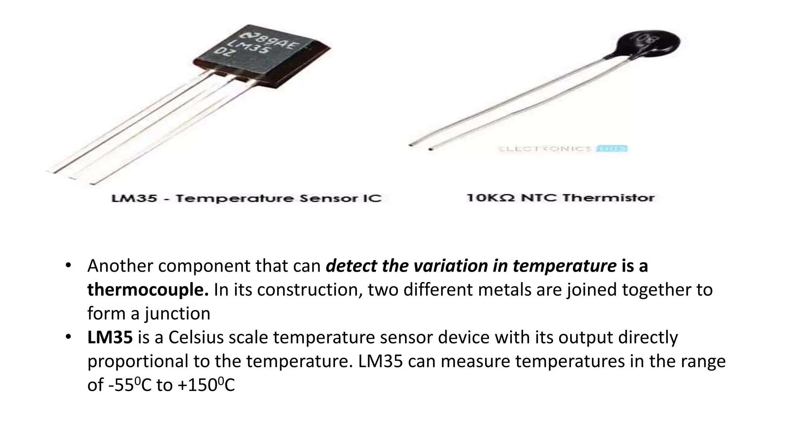
Temperature Sensor
Thermistor
Used to detect the variation in temperature.
It has negative temperature coefficient that means when the temperature increases the resistance decreases.

Slide 12
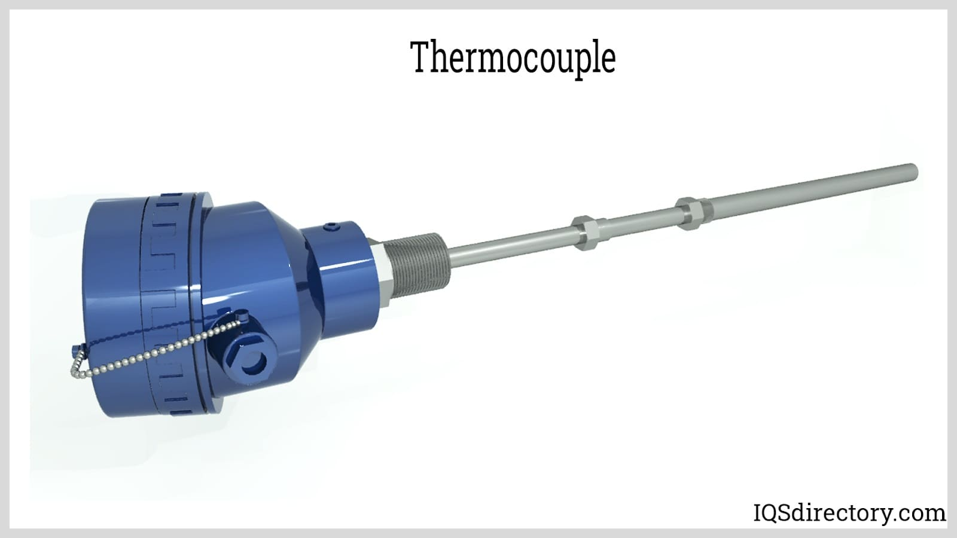
Temperature Sensor
Thermocouple
Detect the variation in temperature also.
It has two different metals are joined together to form a junction.

Slide 13
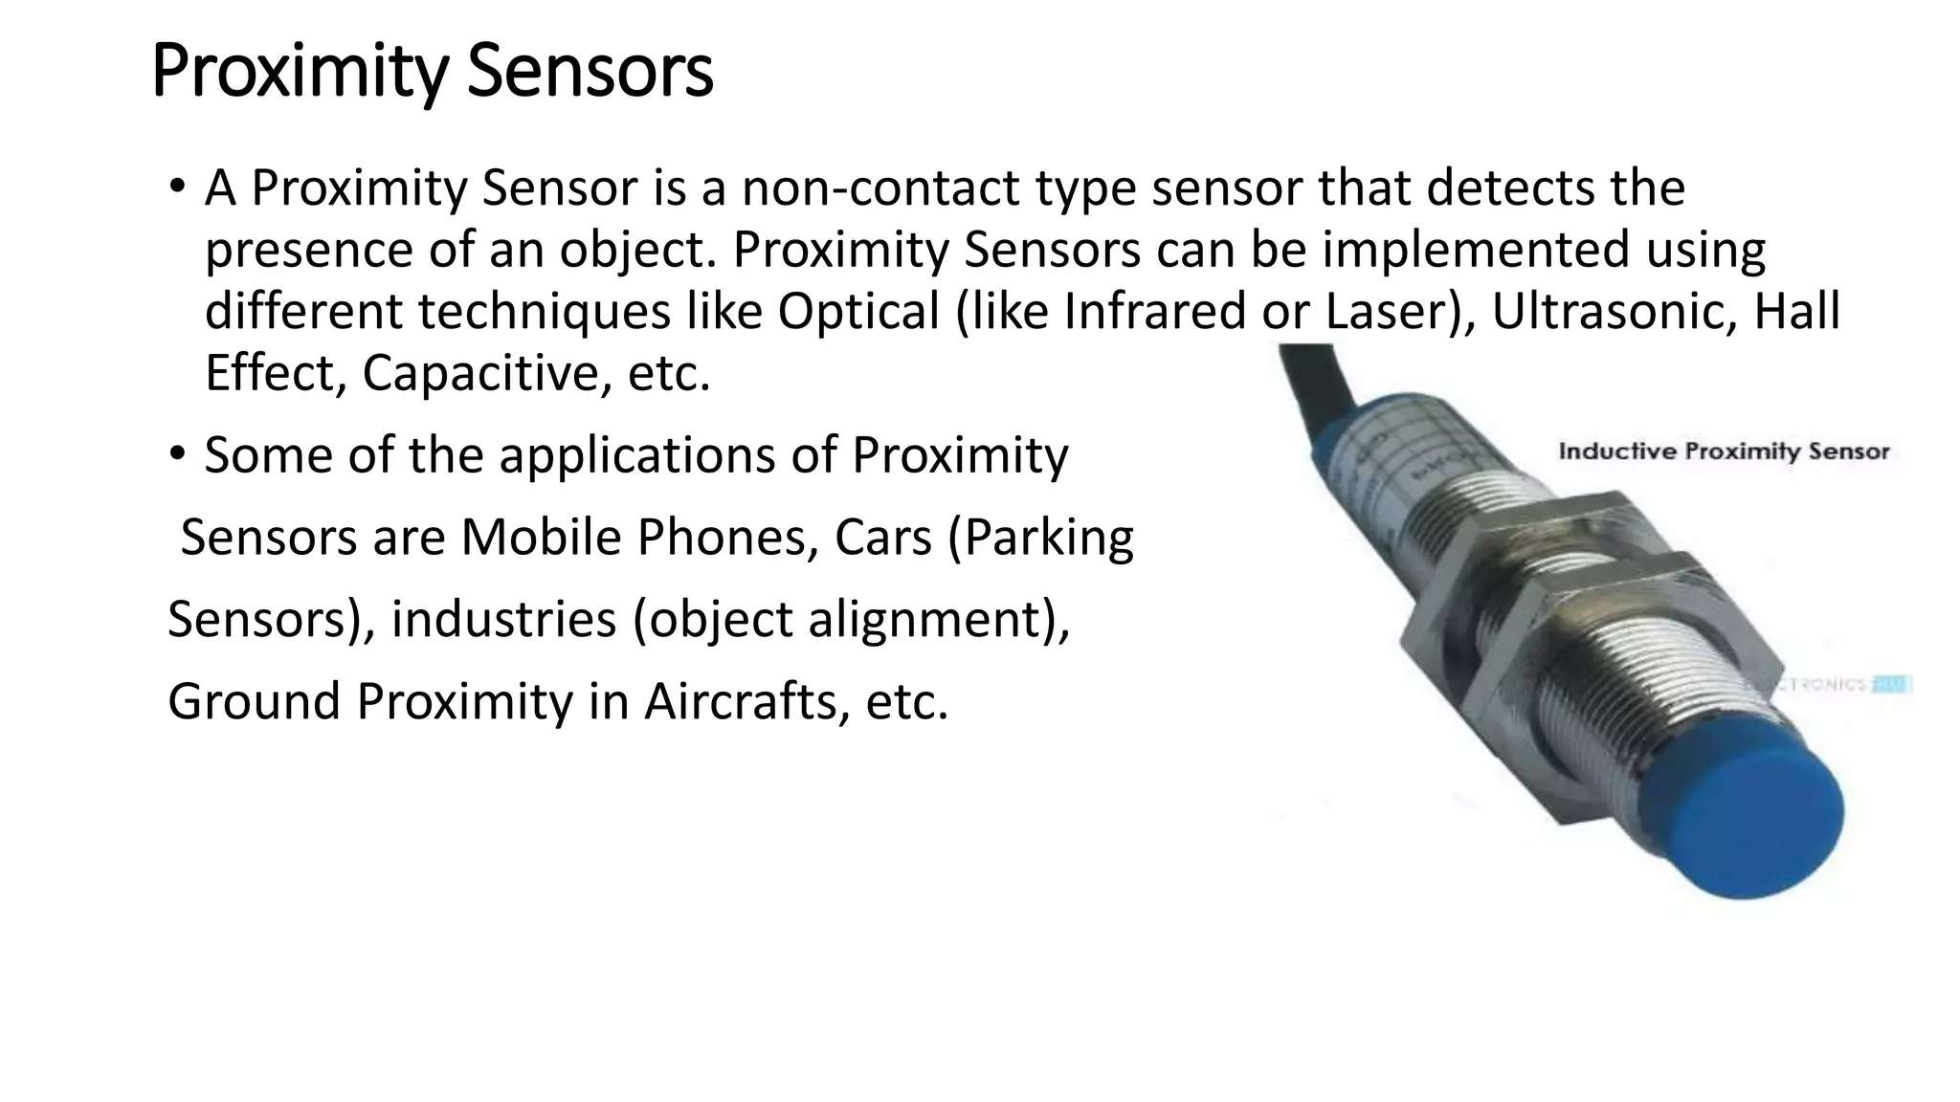
Proximity Sensor
A Proximity Sensor is a non-contact type sensor that detects the presence of an object. Proximity Sensors can be implemented using different techniques like Optical (like Infrared or Laser), Ultrasonic, Hall Effect, Capacitive, etc.

Slide 14
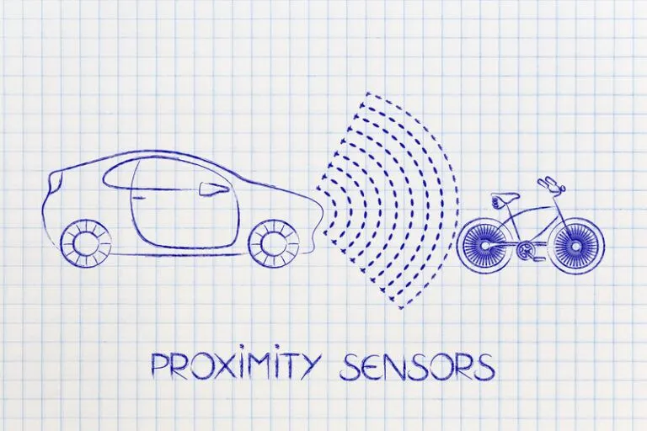
Proximity Sensor
Some of the applications of Proximity Sensors are Mobile Phones, Cars (Parking Sensors), industries (object alignment), Ground Proximity in Aircrafts, etc.

Slide 15
IR Sensor (Infrared)
IR Sensors or Infrared Sensor are light-based sensors that are used in various applications like Proximity and Object Detection. IR Sensors are used as proximity sensors in almost all mobile phones.
There are two types of Infrared or IR Sensors: Transmissive Type and Reflective Type.

Slide 16
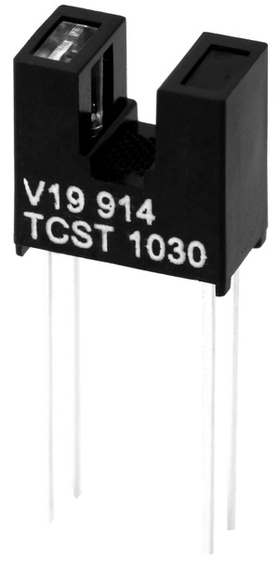
IR Sensor (Infrared)
In Transmissive Type: IR Sensor, the IR Transmitter (usually an IR LED) and the IR Detector (usually a Photo Diode) are positioned facing each other so that when an object passes between them, the sensor detects the object.

Slide 17
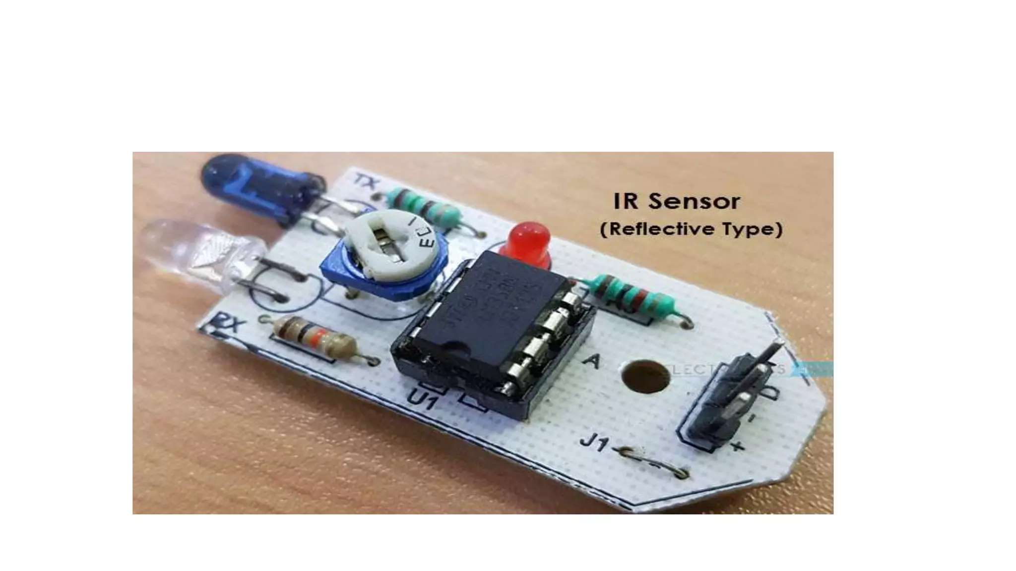
IR Sensor (Infrared)
The other type of IR Sensor is a Reflective Type IR Sensor. In this, the transmitter and the detector are positioned adjacent to each other facing the object. When an object comes in front of the sensor, the sensor detects the object.
Different applications where IR Sensors are implemented are Mobile Phones, Robots, Industrial assembly, automobiles, etc.

Slide 18
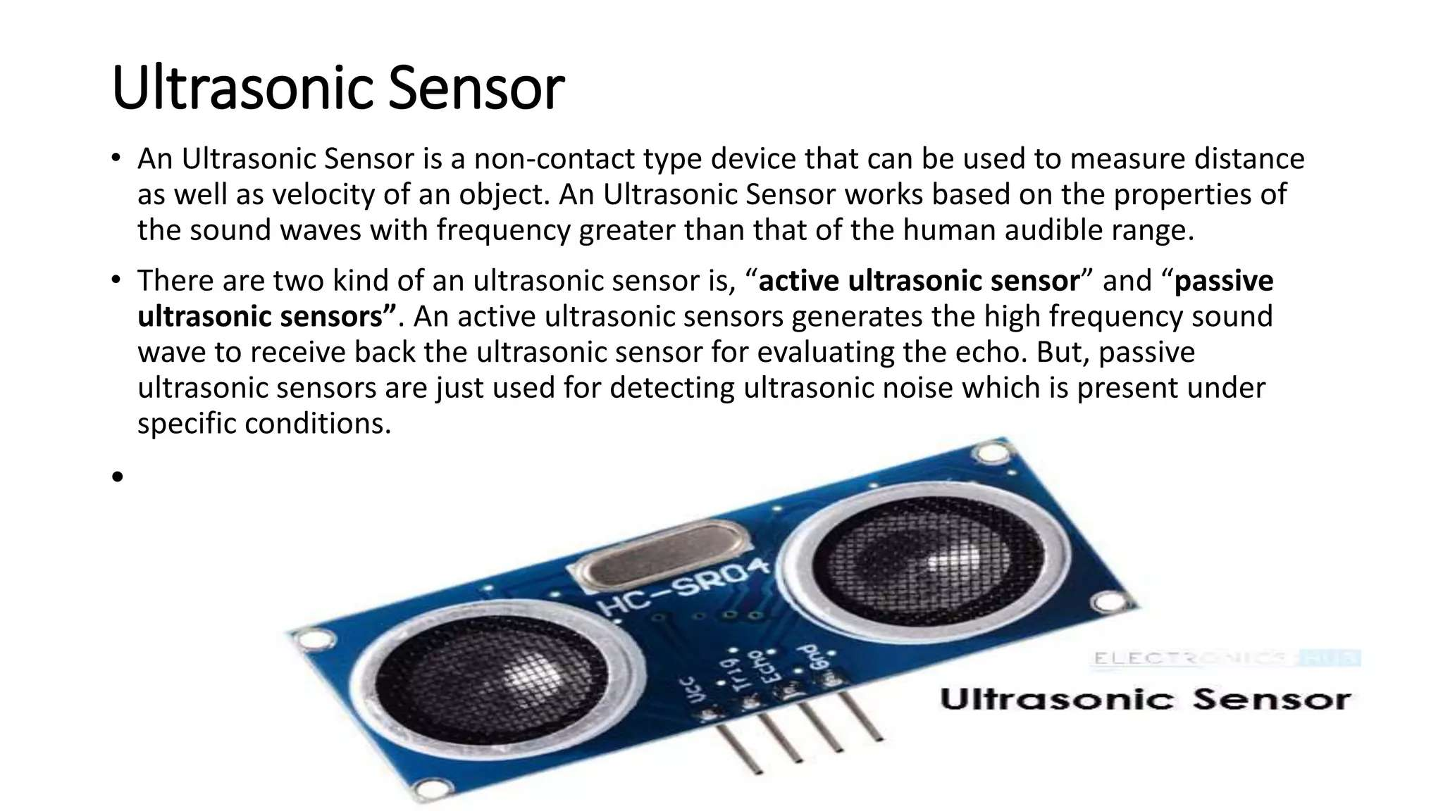
Ultrasonic Sensor
An Ultrasonic Sensor is a non-contact type device that can be used to measure distance as well as velocity of an object. An Ultrasonic Sensor works based on the properties of sound waves with a frequency greater than that of the human audible range.

Slide 19
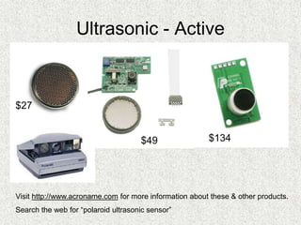
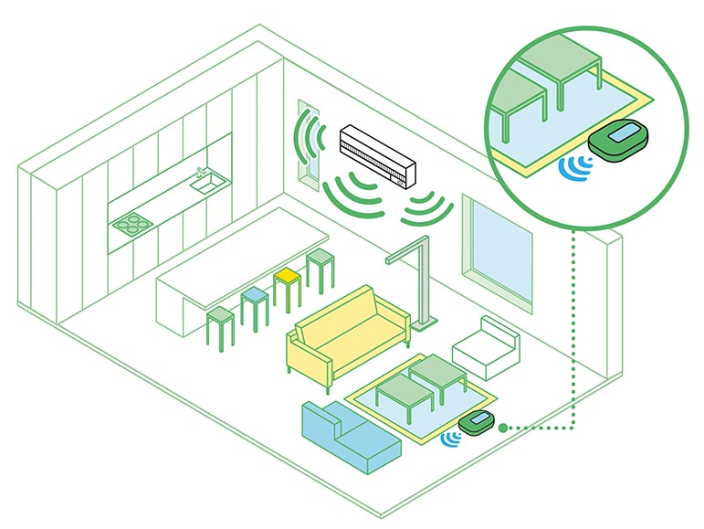
Ultrasonic Sensor
There are two kinds of an ultrasonic sensor, “active ultrasonic sensor” and “passive ultrasonic sensors”.
An active ultrasonic sensor generates the high-frequency sound wave to receive back the ultrasonic sensor for evaluating the echo.
A passive ultrasonic sensors are just used for detecting ultrasonic noise which is present under specific conditions.

Slide 20
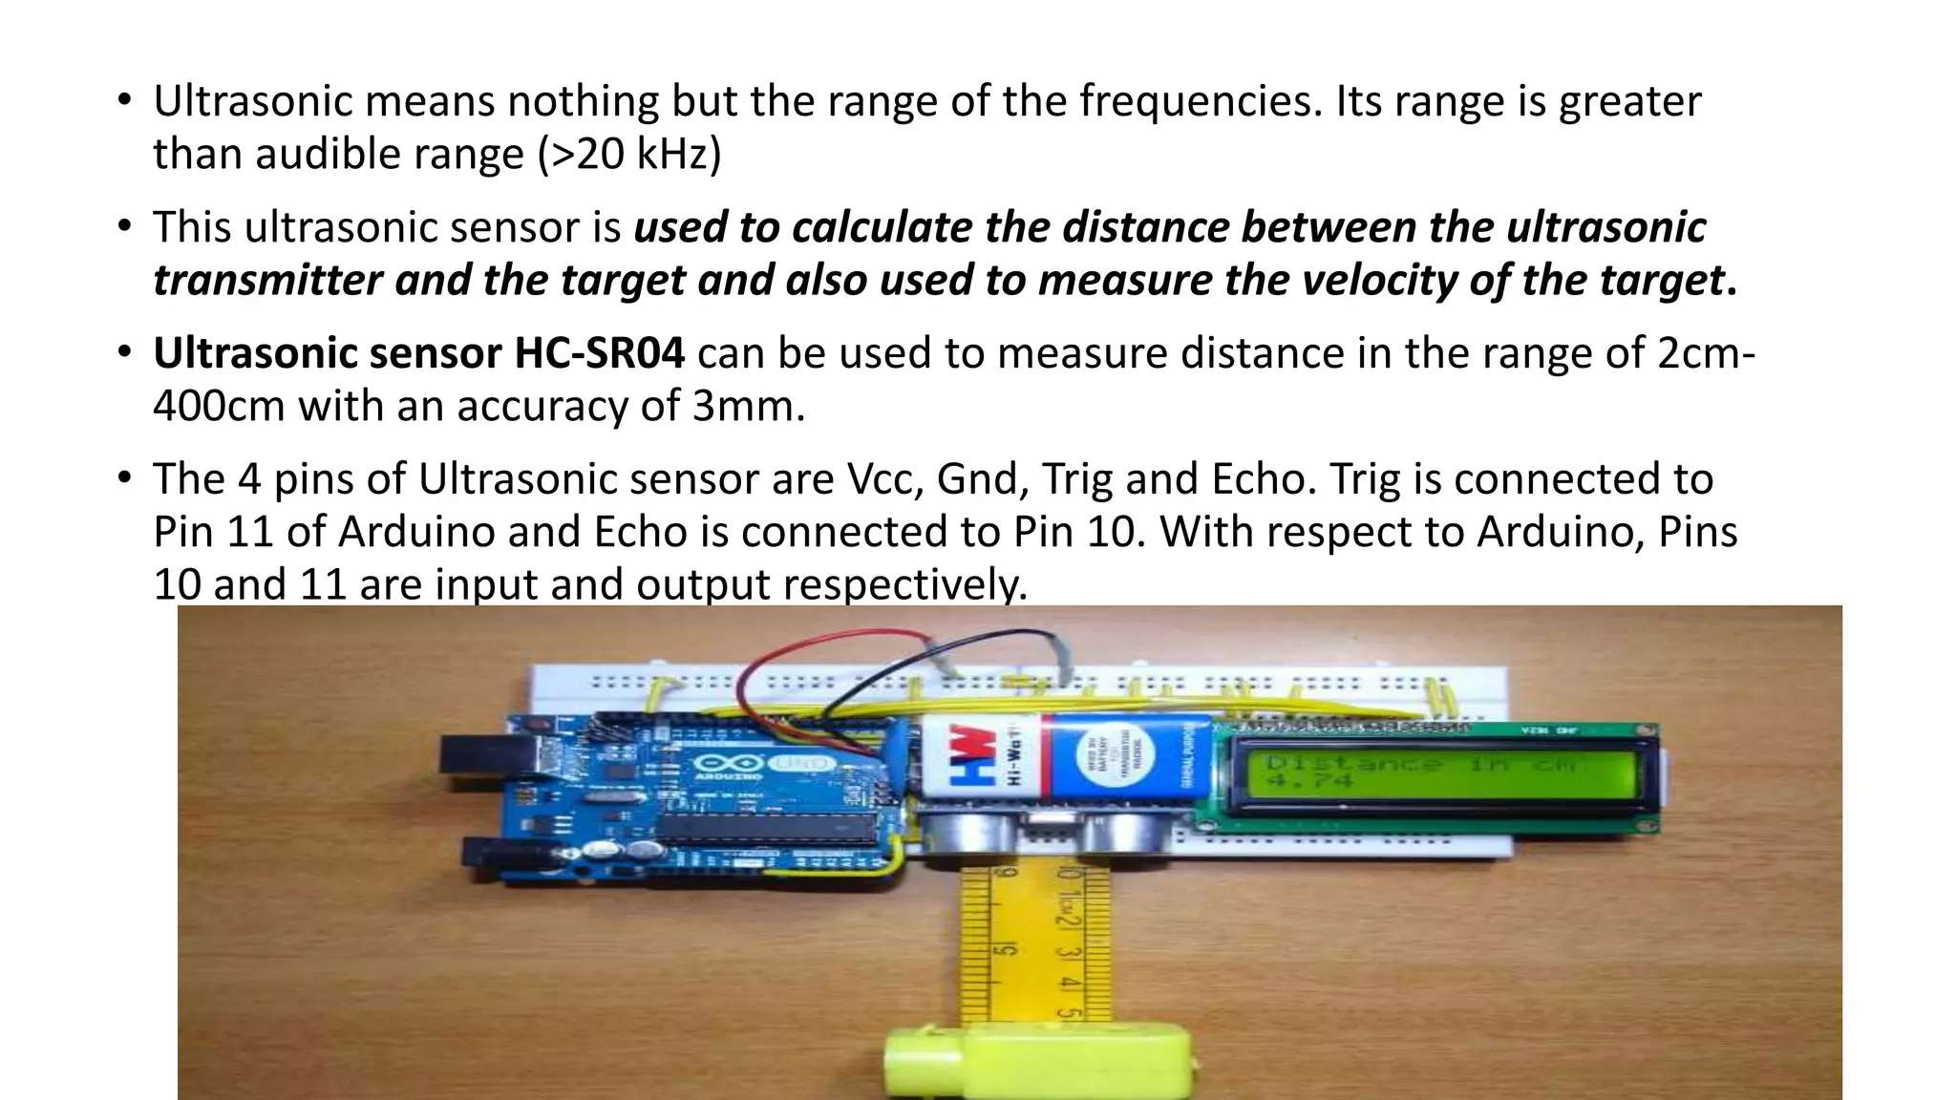
Ultrasonic Sensor
Ultrasonic means nothing but the range of the frequencies. Its range is greater than the audible range (>20 kHz).
This ultrasonic sensor is used to calculate the distance between the ultrasonic transmitter and the target and also used to measure the velocity of the target.
Ultrasonic sensor HC-SR04 can be used to measure distance in the range of 2cm–400cm with an accuracy of 3mm.
The 4 pins of the Ultrasonic sensor are Vcc, Gnd, Trig, and Echo. Trig is connected to Pin 11 of Arduino, and Echo is connected to Pin 10. With respect to Arduino, Pins 10 and 11 are input and output respectively.

Slide 21
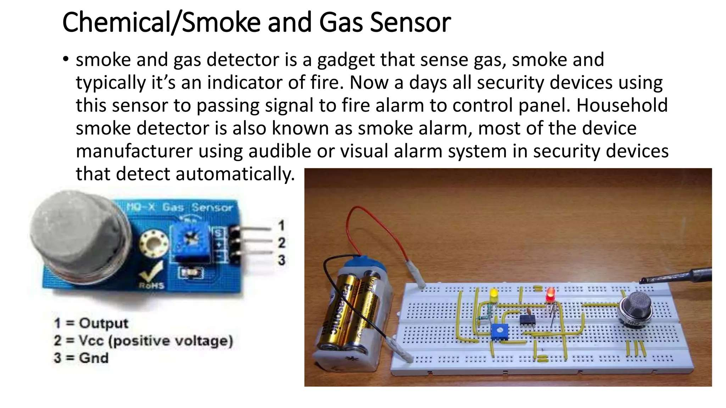
Smoke, Gas and Alcohol Sensor
Smoke and gas detector is a gadget that senses gas, smoke, and typically, it’s an indicator of fire. Nowadays, all security devices use this sensor to pass signals to fire alarms or control panels.
A household smoke detector is also known as a smoke alarm. Most of the device manufacturers use audible or visual alarm systems in security devices that detect automatically.

Slide 22
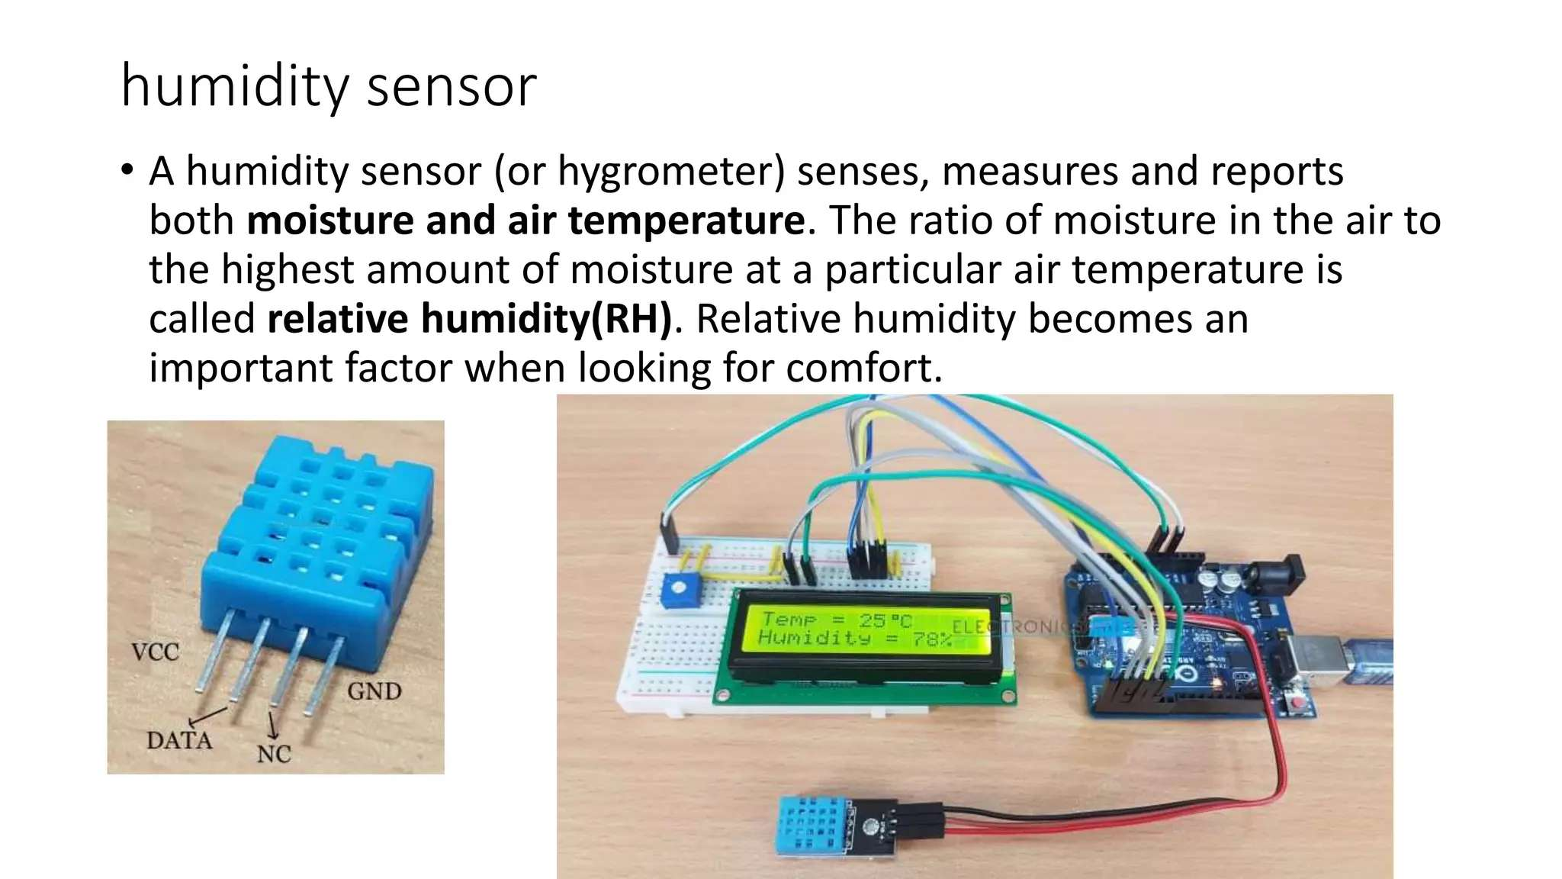
Humidity Sensor
A humidity sensor (or hygrometer) senses, measures, and reports both moisture and air temperature.
The ratio of moisture in the air to the highest amount of moisture at a particular air temperature is called Relative Humidity (RH).
Relative humidity becomes an important factor when looking for comfort.

Slide 23
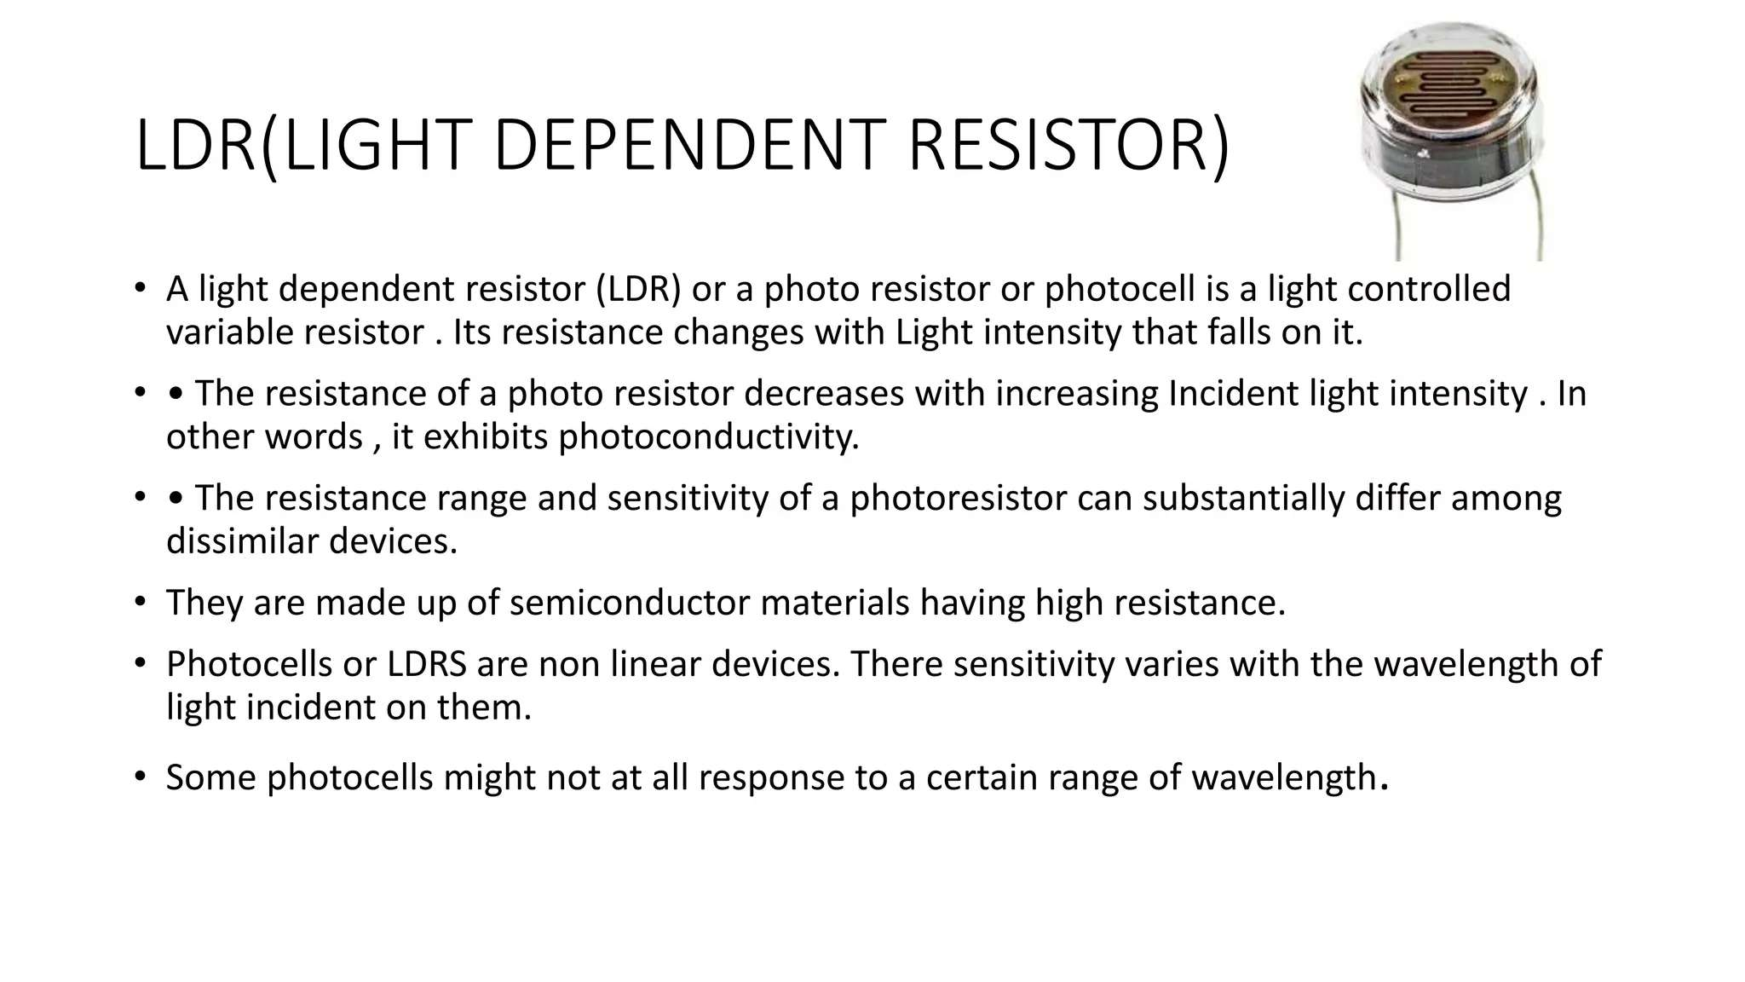
LDR Sensor
A light dependent resistor (LDR) or a photoresistor or photocell is a light-controlled variable resistor. Its resistance changes with light intensity that falls on it.
The resistance of a photoresistor decreases with increasing incident light intensity. In other words, it exhibits photoconductivity.
The resistance range and sensitivity of a photoresistor can substantially differ among dissimilar devices.
They are made of semiconductor materials with high resistance.
Photocells or LDRs are non-linear devices. Their sensitivity varies with the wavelength of light incident on them.
Some photocells might not respond at all to certain ranges of wavelengths.

Slide 24
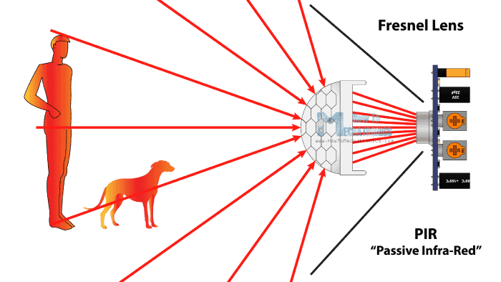
Motion Detection Sensor
A motion detector is an electronic device which is used to detect the physical movement (motion) in a given area, and it transforms motion into an electric signal; motion of any object or motion of human beings.
These are primarily used for intrusion detection systems, automatic door control, boom barrier, smart camera (i.e., motion-based capture/video recording), toll plaza, automatic parking systems, automated sinks/toilet flusher, hand dryers, energy management systems (i.e., Automated Lighting, AC, Fan, Appliances Control), etc.

Slide 25
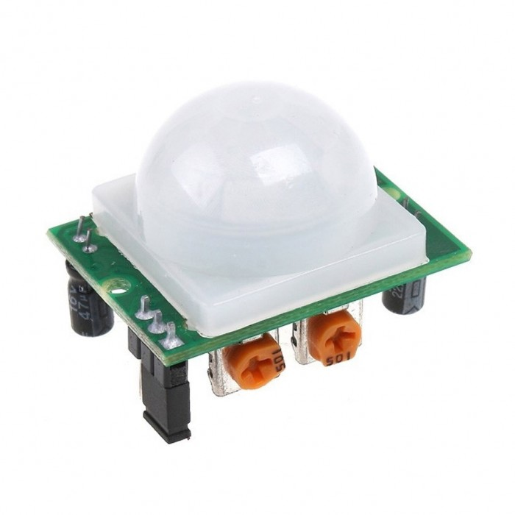
Motion Detection Sensor
Following are key motion sensor types widely used:
Passive Infrared (PIR): It detects body heat (infrared energy) and is the most widely used motion sensor in home security systems.
Ultrasonic: Sends out pulses of ultrasonic waves and measures the reflection off a moving object by tracking the speed of sound waves.
Microwave: Sends out radio wave pulses and measures the reflection off a moving object. They cover a larger area than infrared & ultrasonic sensors, but they are vulnerable to electrical interference and more expensive.

Slide 26
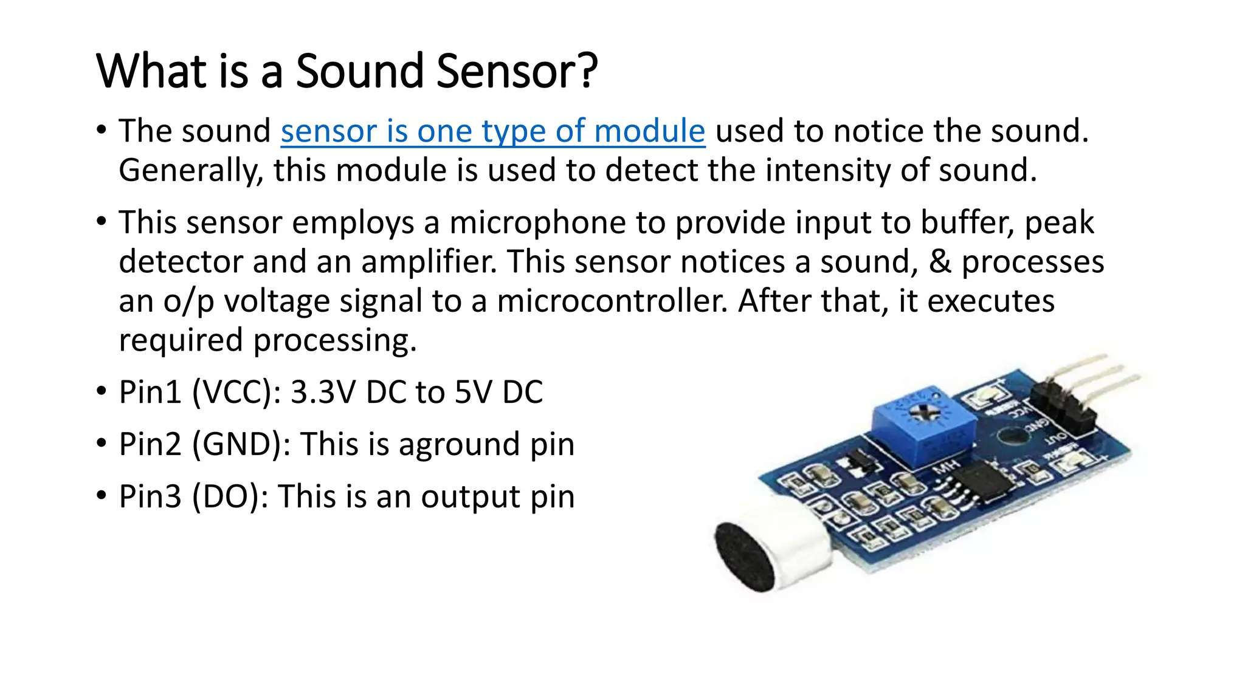
Sound Sensor
The sound sensor is one type of module used to notice the sound. Generally, this module is used to detect the intensity of sound.
This sensor employs a microphone to provide input to buffer, peak detector, and an amplifier. This sensor notices a sound, & processes an output voltage signal to a microcontroller. After that, it executes required processing.
Pin1 (VCC): 3.3V DC to 5V DC
Pin2 (GND): This is a ground pin
Pin3 (DO): This is an output pin

Slide 27
Sensor Characteristic
Resolution
Smallest change in the measurable quantity that a sensor can detect.
Accuracy
The ability of that sensor to measure the environment of a system as close to its true measure as possible
Precision
The principle of repeatability governs the precision of a sensor

Slide 28

30 minutes rest

Slide 29
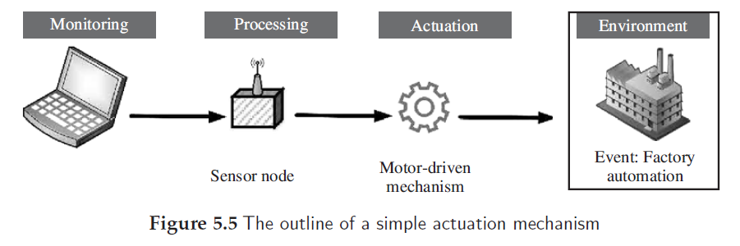
What is Actuator?
Can be considered as a machine or system’s component that can affect the movement or control the said mechanism or the system

Slide 30
Types of Actuator
Hydraulic actuators
Pneumatic actuators
Electric actuators
Thermal or magnetic actuators
Mechanical actuators
Soft actuators
Shape memory polymers

Slide 31
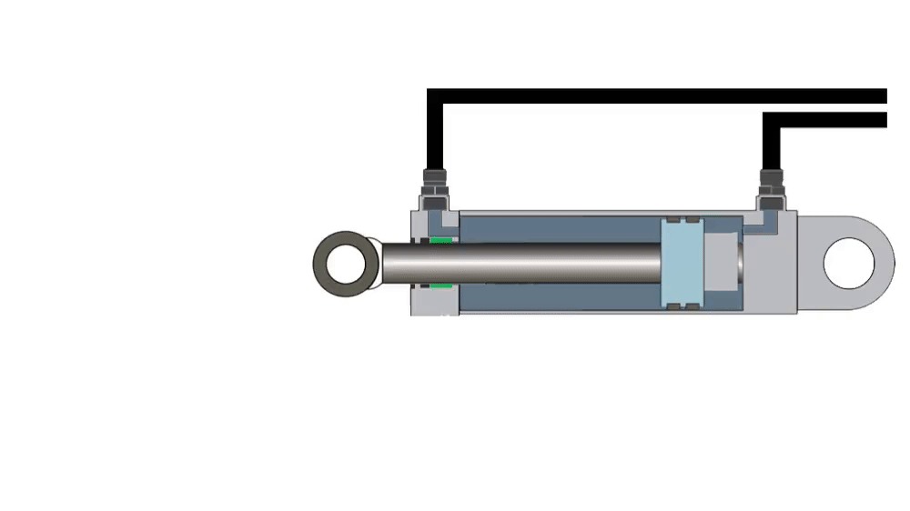
Hydraulic actuators
A hydraulic actuator works on the principle of compression and decompression of fluids.
These actuators facilitate mechanical tasks such as lifting loads through the use of hydraulic power derived from fluids in cylinders or fluid motors.

Slide 32
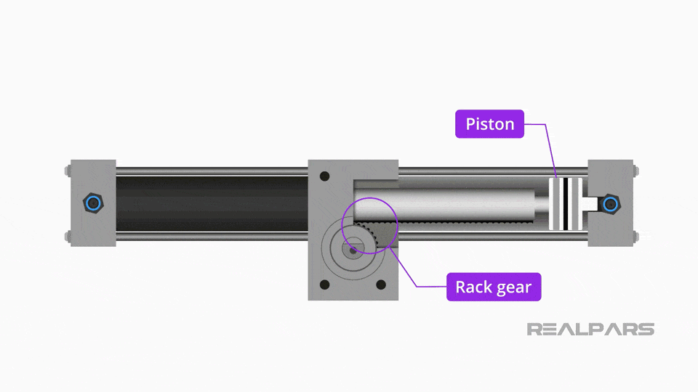
Pneumatic actuators
A pneumatic actuator works on the principle of compression and decompression of gases.
These actuators use a vacuum or compressed air at high pressure and convert it into either linear or rotary motion.

Slide 33
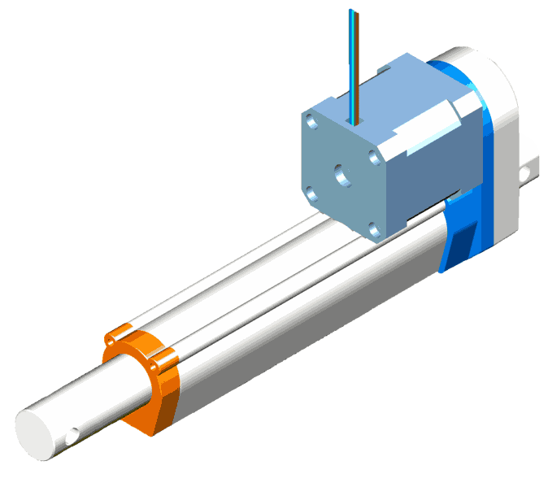
Electric actuators
An electric motors are used to power an electric actuator by generating mechanical torque.
This generated torque is translated into the motion of a motor’s shaft or for switching (as in relays).

Slide 34
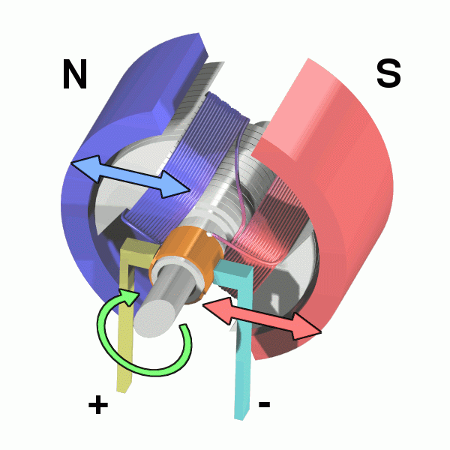
Thermal or magnetic actuators
The use of thermal or magnetic energy is used for powering this class of actuators.
These actuators have a very high power density and are typically compact, lightweight, and economical.

Slide 35
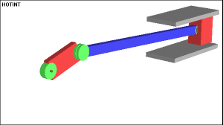
Mechanical actuators
The rotary motion of the actuator is converted into linear motion to execute some movement.
The use of gears, rails, pulleys, chains, and other devices are necessary for these actuators to operate.

Slide 36
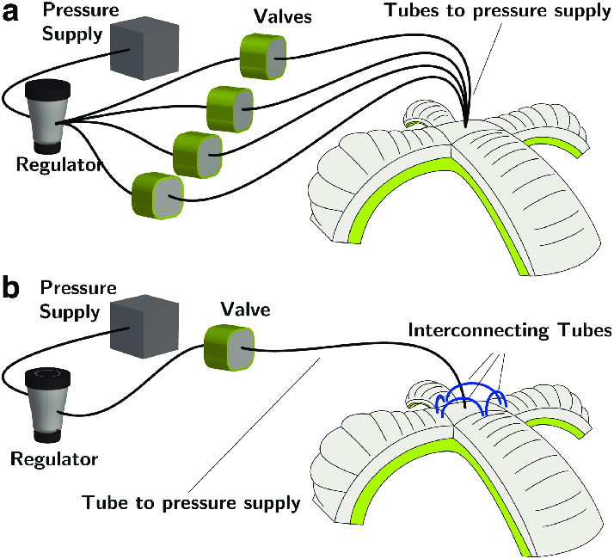
Soft actuators
Soft actuators (e.g., polymer-based) consists of elastomeric polymers that are used as embedded fixtures in flexible materials such as cloth, paper, fiber, particles, and others
The conversion of molecular level microscopic changes into tangible macroscopic deformations is the primary working principle of this class of actuators.
These actuators have a high stake in modern-day robotics.
They are designed to handle fragile objects such as agricultural fruit harvesting, or performing precise operations like manipulating the internal organs during robot-assisted surgeries.

Slide 37
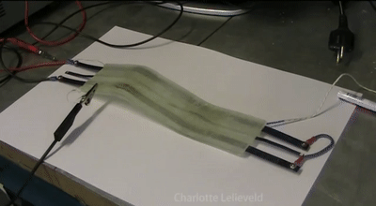
Shape memory polymers
Shape memory polymers (SMP) are considered as smart materials that respond to some external stimulus by changing their shape, and then revert to their original shape once the affecting stimulus is removed.
Features such as high strain recovery, biocompatibility, low density, and biodegradability characterize these materials.
SMP-based actuators function similar to our muscles

Slide 38
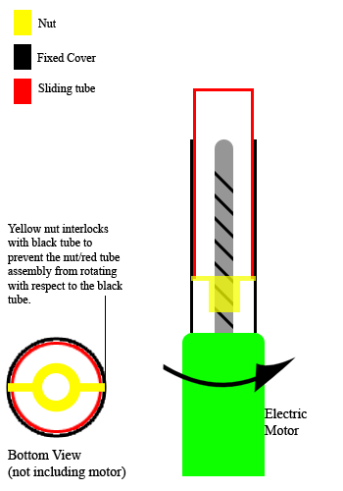
Actuator Characteristics
Weight
Power Rating
Torque to Weight Ratio
Stiffness & Compliance

